Slide 1
KJ's Educational Institute
KJ Clg of Engineering & Management Research
(Accredited by NAAC)
DEPARTMENT OF COMPUTER ENGINEERING
TITLE OF SEMINAR:-
" BUILD YOUR OWN ALEXA ”
BY
07.Nikita Nigade
08.Nimbalkar Akanksha
B19.Patil Shubhangi B20.Pawar Aniruddh
GUIDE :
Prof. Vashali Khobradgade Mam

Slide 2
TABLE OF CONTENTS :
PROJECT GROUP DETAILS
INTRODUCTION
AIM AND OBJECTIVES OF THE PROJECT
LITERATURE SURVEY
SYSTEM ARCHITECTURE
TECHNIQUES / ALGORITHMS
APPLICATIONS / ADVANTAGES
CONCLUSION
REFERENCES

Slide 3
CONTENTS :
PROJECT TITLE :
" BUILD YOUR OWN ALEXA "
DOMAIN :
JARVIS VOICE ASSISTANT
MEMBERS :
Nikita Nigade
Nimbalkar Akanksha
Shubhangi patil
Aniruddh pawar
Saurabh patil

Slide 4
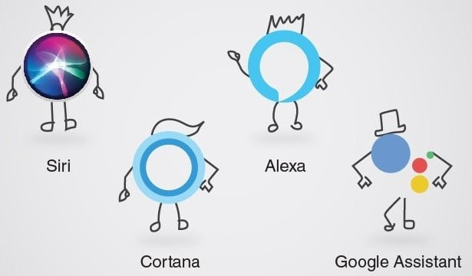
INTRODUCTION :
Today, almost all work has been digitized. We have smartphones in our hands, and these are the world's only possessions at our fingertips. We don't even use our fingers these days. We just have to talk about the work and we're done there is a system You can say "Throw daddy" here. “I will be late today.” And the text was sent. This is the job of the virtual assistant. It also supports specialized tasks such as booking flights online or finding the cheapest book on a variety of e-commerce sites and then provides an order booking interface that helps you automate searches, searches, and online ordering tasks. A virtual assistant is a program that helps make everyday tasks easier, such as displaying the weather forecast, creating reminders, creating a shopping list, and more, and can receive commands via text (online chatbot) or voice. voice based The intelligent assistant needs a challenge or wake word to activate the command next to the listener. for me A design in which the awakening word is JARVIS. There are as many virtual assistants as Apple's Siri, Amazon's Alexa, and Microsoft's Cortana.

Slide 5
Have you ever wondered how cool it would be to have your own A.I. assistant? Imagine how easier it would be to send emails without typing a single word, do Wikipedia searches without opening web browsers, and perform many other daily tasks like playing music with the help of a single voice command.
What can this A.I. assistant do for you?
It can send emails on your behalf.
It can play music for you.
It can do Wikipedia searches for you.
It is capable of opening websites like Google, Youtube, etc., in a web browser.
It is capable of opening your code editor or IDE with a single voice command.

Slide 6
AIM AND OBJECTIVES :
AIM :
The purpose of this project is to create a “VOICE ASSISTANT”, like Google Assistant for Android, and Siri for Ios.
OBJECTIVES :
To understand and carry out the audio instructions given by the user.
To answer phone calls.
To provide human beings with a virtual environment where we can interact with a computer just as we do in the real world.
To minimize the use of input devices like keyboard, mouse, etc. This will reduce both the hardware cost and the time taken by it

Slide 7
LITERATURE SURVEY :
Sr. | Title of the paper | Year of Publication | What you studied from this paper /Seed Idea
1 | JARVIS A VIRTUAL ASSISTANT | July 2021 | This article has examined acknowledgment calculations which are significant in improving voie acknowledgment execution. In this article, the outcomes show that these systems could utilize successfully for voice acknowledgment purposes.
2 | JARVIS VOICE ASSISTANT USING PYTHON | Dec 2021 | In this article, we studied the design and implementation of digital support. This project is built using open-source software modules supported by Visual Studio and may update in the future. This table is useful for disabled and blind people.
3 | Jarvis: Artificial Intelligence-based Voice Assistant | 2022 | Voice assistants are helpful in a variety of areas, including education, household appliances etc. They are beneficial for illiterate people because they obtain information by simply speaking to the assistant.
4 | JARVIS - AI Voice Assistant | 2022 | Jarvis - An AI Voice Assistant System uses speech recognition which can reduce workload of humans’ basic activities and can replace some posts like personal secretaries.
5 | JARVIS: A Virtual Assistant | Feb 2023 | From this article we have studied A Voice Activated Personal Assistant developed using Python. This virtual assistant currently works online and performs basic tasks like weather updates, streaming music, opening desktop applications, etc. The upcoming updates of this assistant will have machine learning incorporated which will result in better suggestions with IoT to control nearby devices similar to what Amazon’s Alexa does.

Slide 8
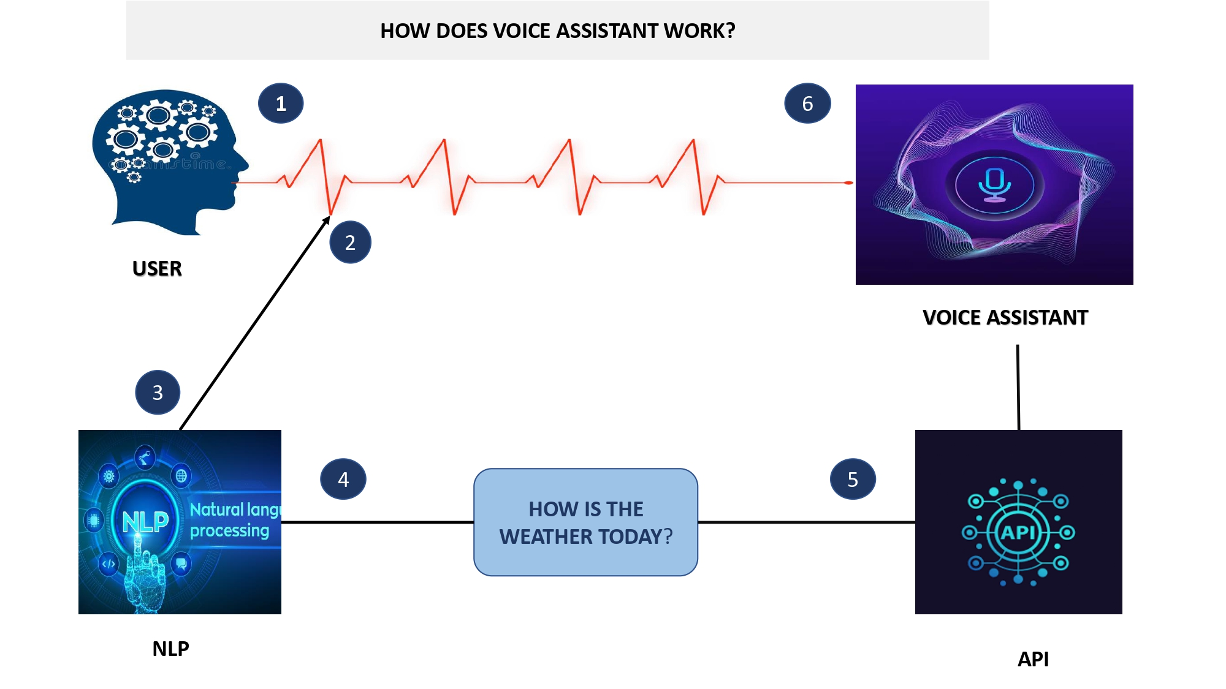
SYSTEM ARCHITECTURE :

Slide 9
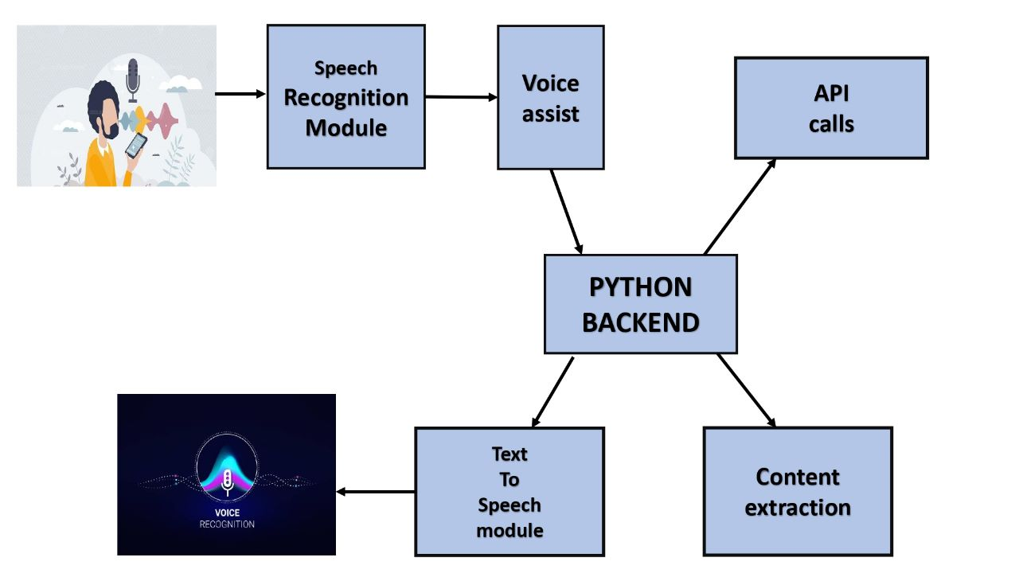

Slide 10
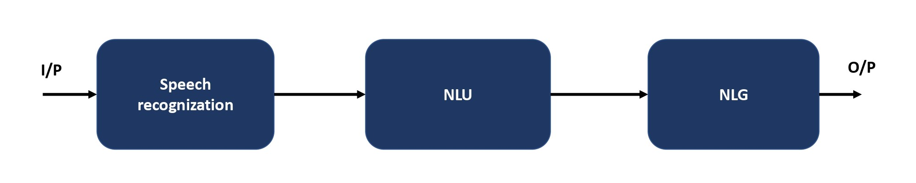
ALGORITHM :
NATURAL LANGUAGE PROCESSING
NLP is an applied artificial intelligence (AI) program that helps your chatbot analyze and understand the natural human language communicating with your customers.
NLP helps chatbots understand, analyze and prioritize the questions according to their complexity & this enables bots to respond to customer queries faster than human beings.

Slide 11
PYTHON LIBRARIES:
pyttsx3: It is a python library that converts text to speech.
speech recognition: It is a python module that converts speech to text.
pywhatkit: It is a Python library to send WhatsApp messages at a particular time with some additional features.
DateTime: This library provides us with the actual date and time.
Wikipedia: It is a Python module for searching anything on Wikipedia.
Smtplib: Simple mail transfer protocol that allows us to send mail and route mail between mail servers.
Pyjokes: It is a Python library that contains lots of interesting jokes in it.
Webbrowser: It provides an interface for displaying web-based documents to users.

Slide 12
Pyautogui: it is a Python library for the graphical user interface.
Os: it represents operating system-related functionality.
Sys: it allows operating on the interpreter as it provides access to the variable and functions that usually interact strongly with the interpreter.
FUNCTIONS:
takeCommand(): The function is used to take the command as input through the microphone of the user and returns the output as a string.
wishMe(): This function greets the user according to the time like Good Morning, Good Afternoon, and Good Evening.

Slide 13
APPLICATIONS :
MULTITASKING: Its main application of it can be its multitasking ability. It can ask for continuous instructions one after the other until the user “QUIT” it.
NO TRIGGER PHASE: It asks for the instruction and listens to the response that is given by the user without needing any trigger phase and then only executes the task.
SAVES TIME: JARVIS is a desktop voice assistant which works on the voice command offered to it, it can do voice searching, voice-activated device control, and can let us complete a set of tasks.
SECURITY: Security testing mainly focuses on vulnerabilities and risks. As JARVIS is a local desktop application, there is no risk of a data breach through remote access. The software is dedicated to a specific system so when the user logs in, it will be activated.
Only one slide

Slide 14
CONCLUSION :
This study has found that generally…JARVIS is a very helpful voice assistant without any doubt as it saves time for the user through conversational interactions, effectiveness, and efficiency. But while working on this project, there were some limitations encountered and also realized some scope for enhancement in the future.
Only one slide

Slide 15
REFERENCES :
Rabiner Lawrence, Juang Bing-Hwang. Fundamentals of Speech Recognition Prentice Hall, New Jersey, 1993, ISBN 0-13015157-2
Deller John R., Jr., Hansen John J.L., Proakis John G., DiscreteTime Processing of Speech Signals, IEEE Press, ISBN 0-78035386-2
Hayes H. Monson, Statistical Digital Signal Processing and Modeling, John Wiley & Sons Inc., Toronto, 1996, ISBN 0-47159431-8
Proakis John G., Manolakis Dimitris G., Digital Signal Processing, principles, algorithms, and applications, Third Edition, Prentice Hall, New Jersey, 1996, ISBN 0-13- 394338-9
Ashish Jain, Hohn Harris, Speaker identification using MFCC and HMM-based techniques, university Of Florida, April 25, 2004.
Subhas mani Kaushal,Megha Mishra(IRJET)volume:07 Issue:09|sep 2020
B. Marr, The Amazing Ways Google Uses Deep Learning AI.
Cortana Intelligence, Google Assistant, Apple Siri.
one or two slides

Slide 16
URL :
http://ieeexplore.ieee.org/stamp/stamp.jsp?tp=&arnumber=895976&isn umber=19391
https://ieeexplore.ieee.org/Xplore/home.jsp
https://en.wikipedia.org/wiki/Main_Page

